Slide 1
Chapter 10
The Foreign Exchange Market
(How foreign exchange market functions and how the value of different currencies is determined)
Notes:
If this PowerPoint presentation contains mathematical equations, you may need to check that your computer has the following installed:
1) MathType Plugin
2) Math Player (free versions available)
3) NVDA Reader (free versions available)

Slide 2
Learning Objectives
Explain how the foreign exchange market works and why exchange rates are importance.
Identify the main factors that affect exchange rates in the long run.
Draw the demand and supply curves for foreign exchange market and interpret the equilibrium in the market for foreign exchange.
List and illustrate the factors that affect the exchange rates in the short run.

Slide 3
Foreign Exchange Market (1 of 2)
Exchange rate: price of one currency in terms of another
Foreign exchange market: the financial market where exchange rates are determined
Spot transaction: immediate (two-day) exchange of bank deposits
Spot exchange rate
Forward transaction: the exchange of bank deposits at some specified future date
Forward exchange rate

Slide 4
Foreign Exchange Market (2 of 2)
Appreciation: a currency rises in value relative to another currency
Depreciation: a currency falls in value relative to another currency
When a country’s currency appreciates, the country’s goods become more expensive to foreigners and foreign goods in that country become less expensive to domestic economic agents.
Over-the-counter market mainly banks

Slide 5
Exchange Rates in the Long Run
Law of one price: the prices of an identical good should be the same throughout the world if trade barriers are low
Theory of Purchasing Power Parity assumptions:
All goods are identical in both countries
Trade barriers and transportation costs are low
Many goods and services are not traded across borders

Slide 6
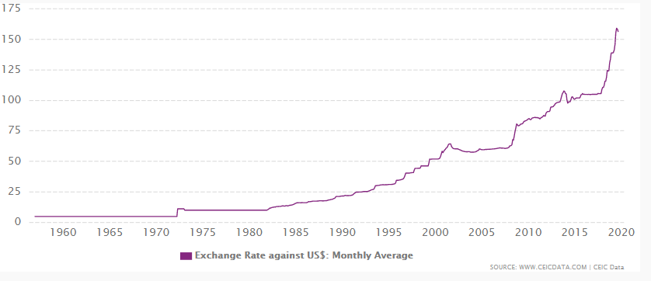
Exchange Rate of PKR to USD
Source: https://www.ceicdata.com/en/indicator/pakistan/exchange-rate-against-usd

Slide 7
Factors That Affect Exchange Rates in the Long Run
The basic rule: Anything that increases the demand for domestically produced goods relative to foreign traded goods tends to appreciates domestic currency
Relative price levels
Trade barriers
Preferences for domestic versus foreign goods
Productivity

Slide 8
Summary Table 1 Factors That Affect Exchange Rates in the Long Run
Factor | Change in Factor | Response of the Exchange Rate, E*
Domestic price level† | ↑ | ↓
Trade barriers† | ↑ | ↑
Import demand | ↑ | ↓
Export demand | ↑ | ↑
Productivity† | ↑ | ↑
*Units of foreign currency per dollar: ↑ indicates domestic currency appreciation; ↓, depreciation.
†Relative to other countries.
Note: Only increases (↑) in the factors are shown; the effects of decreases in the variables on the exchange rate are the opposite of those indicated in the “Response” column.

Slide 9
Exchange Rates in the Short Run: A Supply and Demand Analysis
An exchange rate is the price of domestic (dollar) assets in terms of foreign assets
Supply curve for domestic assets
Assume amount of domestic assets is fixed (supply curve is vertical)
Demand curve for domestic assets
Most important determinant is the relative expected return of domestic assets
At lower current values of the dollar (everything else equal), the quantity demanded of dollar assets is higher

Slide 10
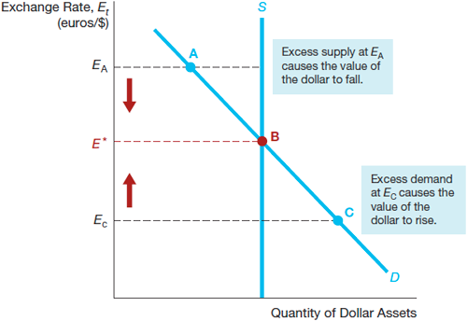
Figure 2 Equilibrium in the Foreign Exchange Market

Slide 11
Explaining Changes in Exchange Rates
Shifts in the demand for domestic assets
Domestic interest rate
Foreign interest rate
Expected future exchange rate

Slide 12
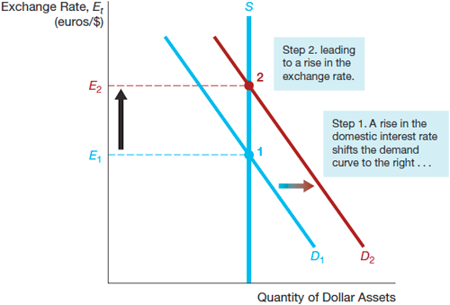
Figure 3 Response to an Increase in the Domestic Interest Rate, i^{D}

Slide 13
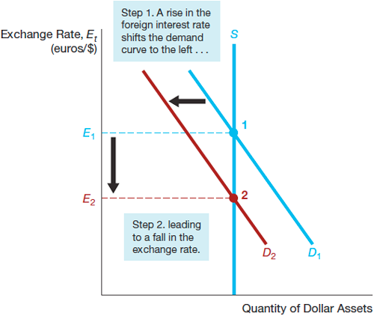
Figure 4 Response to an Increase in the Foreign Interest Rate, i^{F}

Slide 14
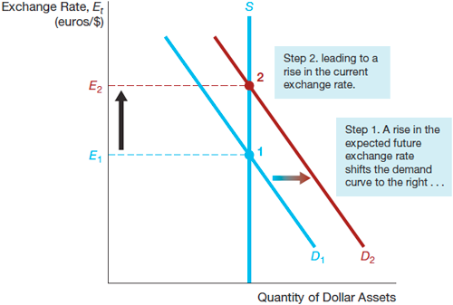
Figure 5 Response to an Increase in the Expected Future Exchange Rate, E^{e}_{t+1}

Slide 15
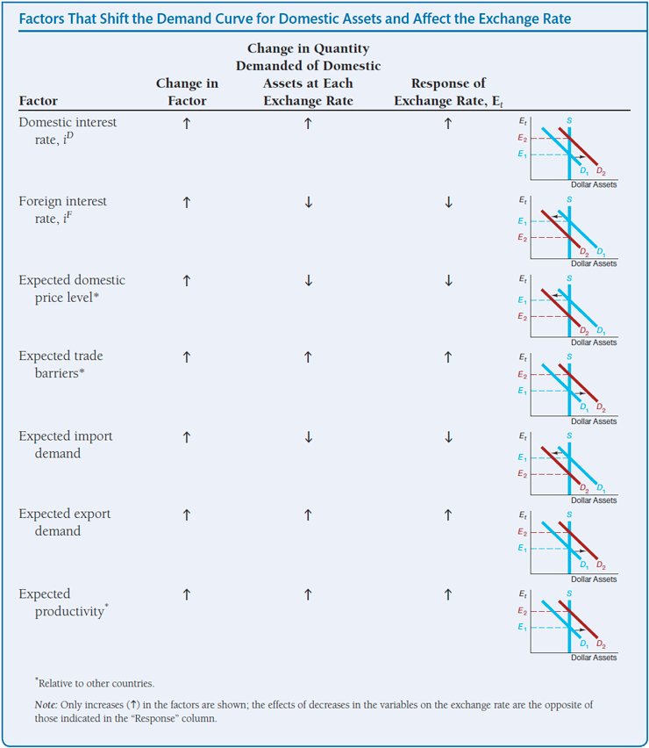
Summary Table 2 Factors That Shift the Demand Curve for Domestic Assets and Affect the Exchange Rate

Slide 16
Application: Effects of Changes in Interest Rates on the Equilibrium Exchange Rate
Changes in Interest Rates
When domestic real interest rates raise, the domestic currency appreciates.
When domestic interest rates rise due to an expected increase in inflation, the domestic currency depreciates.
Changes in the Money Supply
A higher domestic money supply causes the domestic currency to depreciate.

Slide 17
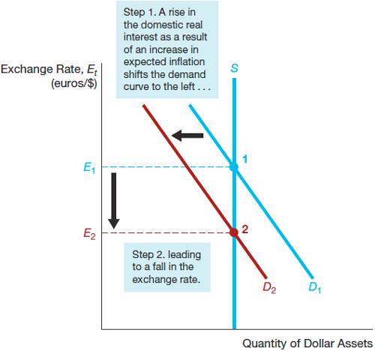
Figure 6 Effect of a Rise in the Domestic Interest Rate As a Result of an Increase in Expected Inflation

